Slide 1



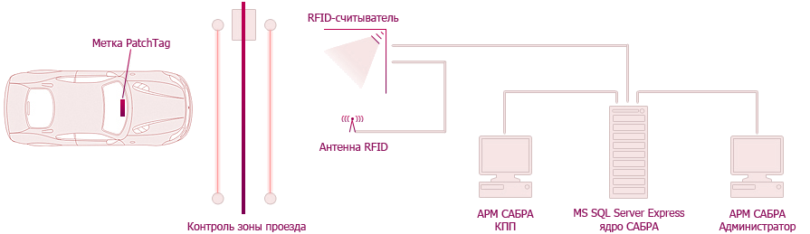
ABOUT
SABRA – Vehicle Registration Automatic System
SABRA is hardware-software solution. It consists of RFID-tags, UHF RFID reader Impinj Speedway Revolution and proprietary software

Slide 2



SYSTEM VERSIONS
SABRA for controlling one checkpoint
Requires installation on workstation
SABRA: network for control of several checkpoints
Requires installation on server
SABRA: light for installation on UHF RFID reader.
Don’t need workstation

Slide 3
TARGET AUDIENCE
SABRA can be used:
in factory parking lot
in logistic center
in mall and residential real estate parking lot
in public transportation depot
in parking lot for oversized vehicles (trucks, agricultural machinery)
at toll highway
at airport, port, railway station
In other areas with restricted entry and movement control

Slide 4
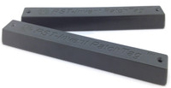
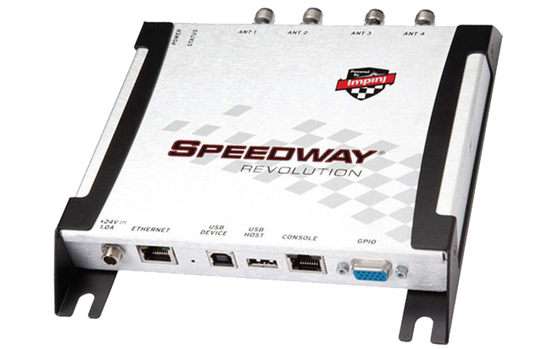
TECHNOLOGY
RFID-Tag is a small device used to store and transfer information. Each tag has a unique ID and doesn’t require a power supply
RFID-reader is a device for reading and writing
information on RFID-tag.
SABRA uses the world’s best reader
Impinj Speedway

Slide 5
WORKING PRINCIPLE
RFID-Tag can be fixed to the windshield of the car
RFID-readers antennas are mounted above the gate of checkpoint
Software integrates all SABRA components
Antenna receives the unique ID of the RFID tag and determines the characteristics of the vehicle
The system displays information about the car and opens the gate. It can use voice informing about the event (optional)
If necessary, operator receives the image from the DVR and can manage the access control devices

Slide 6



ADVANTAGE
Saving time
The system does not need for a full stop of vehicle. The system does not need for direct contact. It reduces the time of registration
Automation of accounting
All system components are optimized for smooth operation. The system operator is only needed in exceptional cases
Distance
Passive RFID tags PatchTag are long distance tags. The reader can work with them within a radius of about 8-10 meters and registers the vehicle at a speed up to 150 kmh

Slide 7



ADVANTAGE
Work with a large number of tags
The system detects multiple RFID tags simultaneously and prevents congestion in front of the checkpoint
User friendly interface
You need a little time to learn how to manage the system. The software may perform many different operations. The equipment is integrated into existing computer network becoming its internal part
Monitoring
The system registers the direction of movement, displays information about movement of vehicles in a certain area and reports about faulty equipment

Slide 8

OPPORTUNITIES
SABRA:
Can Identify vehicle on checkpoint
Records the direction of movement in the database
Displays information about the car at the checkpoint
Implements device management access control in automatic mode
Sets rules for unattended operation of devices for access control on the basis of the car's number
to obtain statements about the movement of vehicles on various parameters

Slide 9

EXTRA MODULES
Branches integration
Integration of two and more copies of SABRA in different areas. Identification of vehicles from other branches
Principle
The car leaves branch #1
The system registers the passage of the car and stores this information in database, calculating the estimated arrival time
The car arrives at the branch #2
SABRA registers the fact of the departure and the arrival time of the vehicle. Informing the operator of the system about the journey time

Slide 10

EXTRA MODULES
Marking of railway cars
Used to track the movement and location of wagons in the railway routes of the factories and on freight stations
Principle
Reception area equipped with devices for the identification of rolling stock
The module receives the time of registration and the status of rolling stock (empty/Laden/repair/ flushing) in respective zones
The interaction of weighting scales and module SABRA organizes collection of information about weight of empty and loaded rolling stock
Weighing results are saved together with the data about railway wagons
The module determines the logic of the system on territory of the factory or the freight station (enables/disables passage, assigns the path, etc.)

Slide 11

EXTRA MODULES
Automatic license plate recognition
Uses optical character recognition to read vehicle license plates
Principle
The car pulls up to a checkpoint area
ANPR Module records the number
SABRA Software compares the obtained number with the number registered in the system
In case of information coincidence the system authorizes travel;
In case of absence of the license plate in the database the system prohibits the passage

Slide 12
EXTRA MODULES
Informing about the event
Service to provide information about crossing checkpoint by e-mail and SMS (optional)
Principle
The car crosses the checkpoint
The system records the date, time and direction of travel
The module sends information by email or SMS to your mobile phone
SMS

Slide 13
EXTRA MODULES
Pass оnline order form
Registration of vehicles not equipped with RFID tags using a bar code
Principle
The user enters the required data, the system puts the necessary information
into the database
The operator reviews the request and endorses the passage
The system generates a pass-ID and sends an e-mail form with a barcode containing information about the number of authorized entries-departures
The user receives the form by e-mail
Optionally, you can use the form Informing about events

Slide 14
EXTRA MODULES
The number of free Parking spaces
Automatically determines the number of seats available, informs the driver
Principle
Information about number of Parking spaces stored in the database
The system records the direction of travel
When the car pulls into the Parking the number of available seats on a Board is reduced by one. When the car leaves Parking – unit is increased
In the multi-Parking zone, the system records the direction of travel through the territory, the scoreboard shows the number of seats available in each zone

Slide 15
EXTRA MODULES
Location in a limited area
Allows the operator to see the number of vehicles in different zones
Principle
RFID readers are installed in each passage
The system records the fact of intersection and records the identifier
The monitor displays information about location of a certain car in a certain area
Information can be presented in table form or on the map

Slide 16

EXTRA MODULES
Technical condition of vehicles database
SABRA maintains a database of technical condition of registered vehicles
Principle
The ID of the RFID tag relates not only to information about driver and car, but also to the technical condition of vehicle

Slide 17
EXTRA MODULES
SABRA for touchscreen devices
SABRA software is optimized for all popular touchscreen mobile devices: iOS-, Android- and Windows Mobile-based
Principle
SABRA interface for touchscreen devices uses all functions of operator workspace including additional modules

Slide 18

EXTRA MODULES
Weight check
Solution for industries where it is necessary to control the transportation of bulk materials and waste
The module contains information about the vehicle, driver, cargo status (loaded/empty)
Principle
Truck scales are integrated with the SABRA System
The machine comes in the area of the checkpoint, operators get information about the machine, the weight of goods, destination point
Upon arrival at the destination point the vehicle passes the weighing process, the system checks the weight of transported goods

Slide 19

EXTRA MODULES
Monitoring the route of special equipment
To prevent unauthorised use of specialized vehicles, forklifts, etc.
Principle
In the control points of the route RFID readers are installed
Special vehicles are equipped with RFID-tags
SABRA captures information about passing through checkpoints
In case of deviation from the route, long idle time or unauthorized movement the system informs the operator
The module keeps history of movements and forms reports.

Slide 20
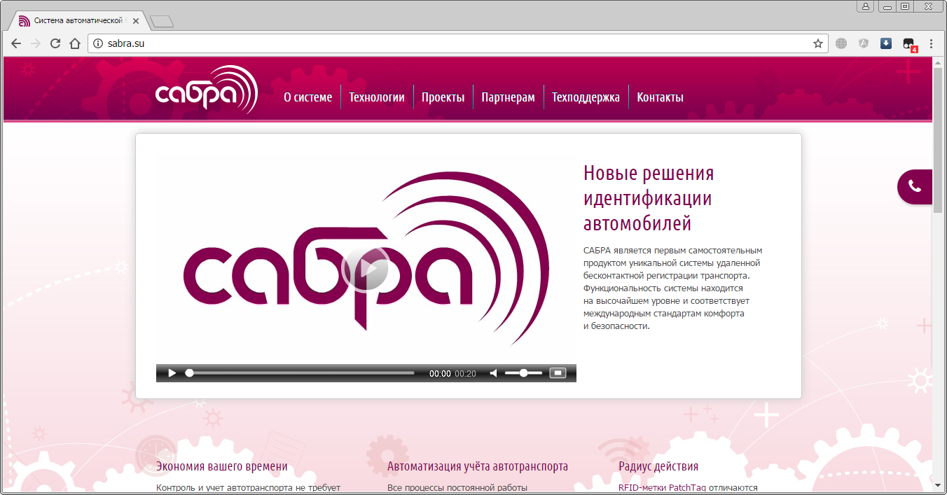
PROMO SITE
Full information about SABRA on http://sabra.su/

Slide 21
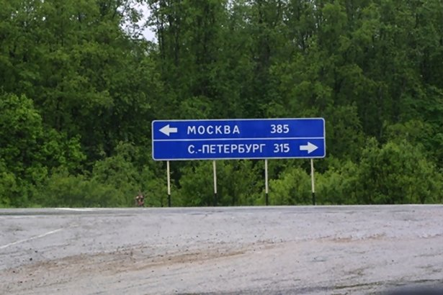
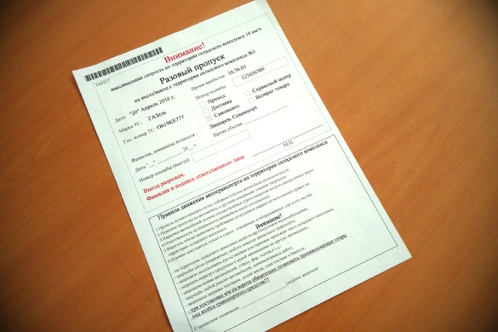
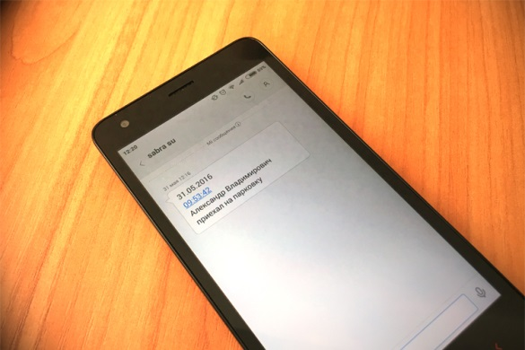
COMPLETED PROJECTS
Warehouses OCS.
2016 Moscow / St. Petersburg.
Branches integration module installed
Logistics complex NCC. 2016 Moscow.
The pass printing module with the event alert module installed
Warehouse complex Admiral-Gorelovo.
2016. St. Petersburg.
The pass printing module with the event alert module installed

Slide 22
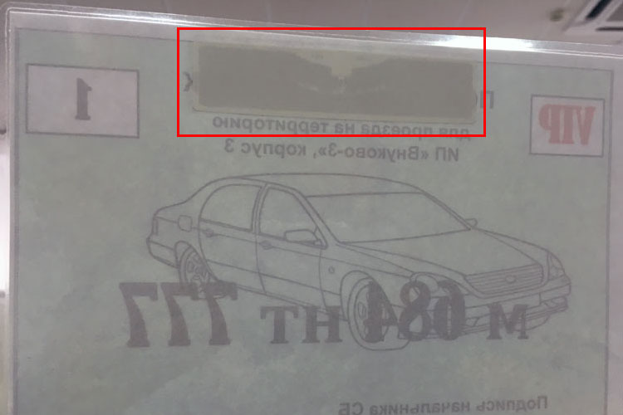
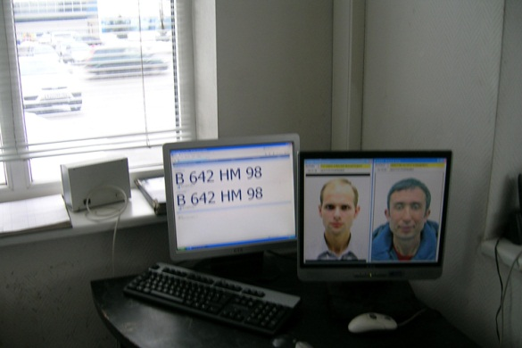
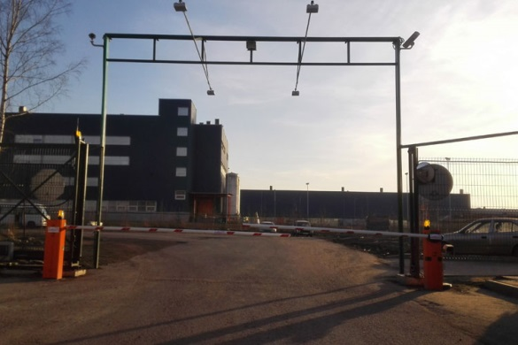
COMPLETED PROJECTS
Logistics complex NCC. 2015 Moscow.
Uses of laminated heat resistant RFID tags
Baltika brewery Head-office. 2014 St. Petersburg.
Actual version SABRA
Warehouse complex Admiral-Gorelovo.
2014. St. Petersburg.
100 vehicles in system. Installed car licence plates identify module.

Slide 23
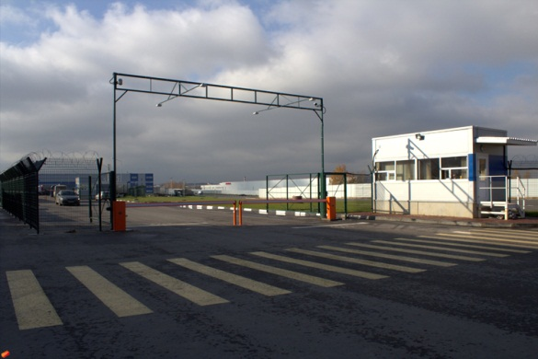
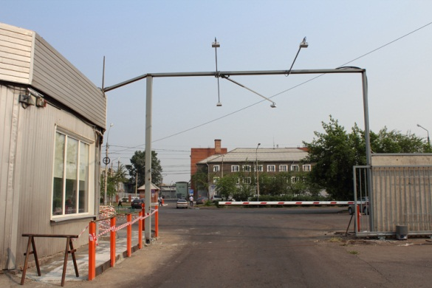
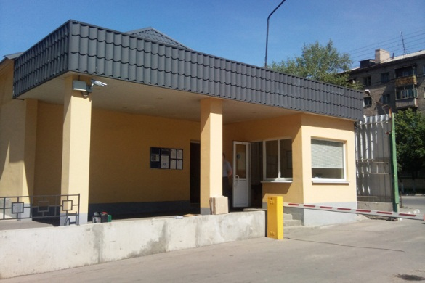
COMPLETED PROJECTS
Logistics complex NCC. 2013 Moscow.
500 vehicles in system. Car licence plates identify module installed
Baltika-Pikra brewery. 2012 Krasnoyarsk.
350 vehicles in system.
Baltika-Voronezh brewery. 2010 Voronezh.
350 vehicles in system.

Slide 24
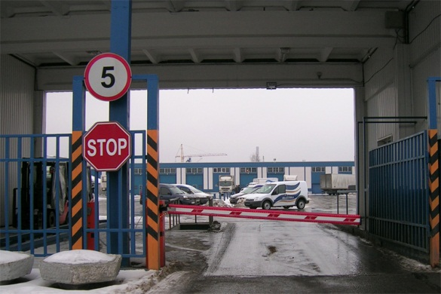
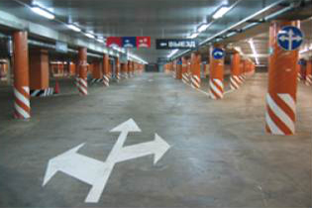
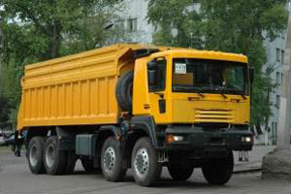
COMPLETED PROJECTS
Baltika brewery Head-office. 2009 St. Petersburg.
350 vehicles in system.
Parking in a luxury building.
2009. Moscow.
200 vehicles in system.
Truck's labelling and weight control.
2008. Lesyazhny mining processing plant
40 vehicles in system.

